Slide 1
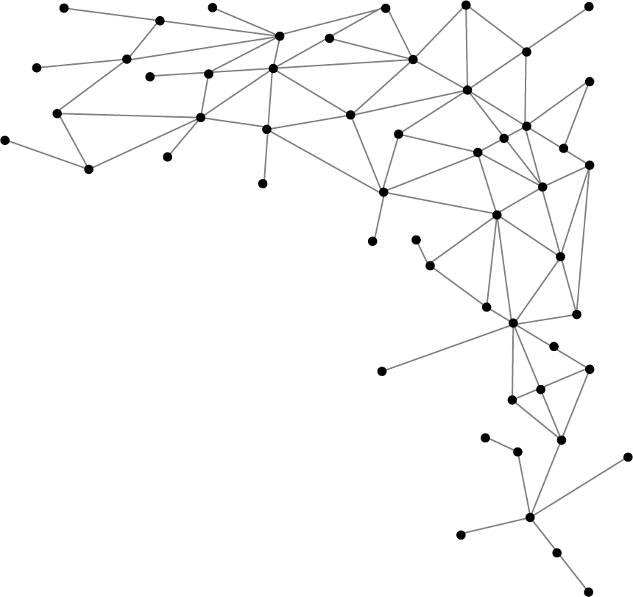




Machine Learning
I am Saif Hassan
Lecturer (CS@SIBAU)
@saifhassandr
@saifhassandr

Slide 2
Agenda
Weather Dataset
Terminology
Supervised/Unsupervised with Examples

Slide 3
Weather Dataset
Goal → Predict Play or Not?
Outlook | Temperature | Humidity | Windy | Play
overcast | hot | high | FALSE | yes
overcast | cool | normal | TRUE | yes
overcast | mild | high | TRUE | yes
overcast | hot | normal | FALSE | yes
rainy | mild | high | FALSE | yes
rainy | cool | normal | FALSE | yes
rainy | cool | normal | TRUE | no
rainy | mild | normal | FALSE | yes
rainy | mild | high | TRUE | no
sunny | hot | high | FALSE | no
sunny | hot | high | TRUE | no
sunny | mild | high | FALSE | no
sunny | cool | normal | FALSE | yes
sunny | mild | normal | TRUE | yes
Hypothesis: we only play when it’s sunny?
No, because we also play when it’s overcast
Hypothesis: we don’t play if it’s windy and rainy?
No, because we don’t play in other cases too.

Slide 4




Terminology
Female
Male
Classification (Categorical/Discrete)
Gender (Male and Femlae)
Regression (Continuous)
Age of Person (17, 18.5, 33)
Score of Player in Sports
Age: 5.5 years
Age: 65 years

Slide 5
Terminology
Supervised Learning (Training)
Provided output to associated input in dataset (Labeled Data)
Detect and learn pattern/relationship between I/O.
Example: Classification, Regression
Unsupervised Learning (Sometimes: Mining)
Only input is provided (Unlabeled Data)
Example: Clustering, Dimension Reduction

Slide 6
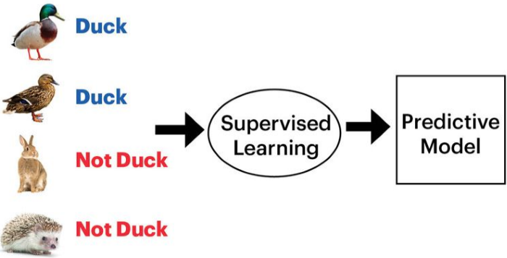
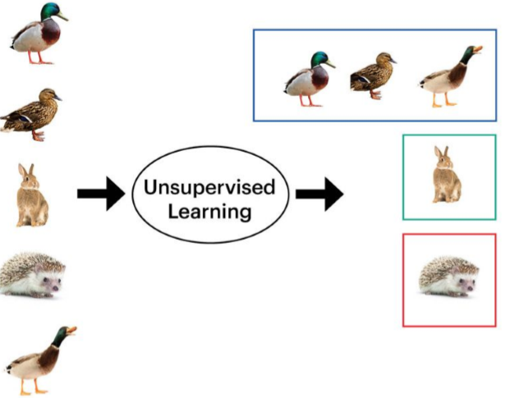
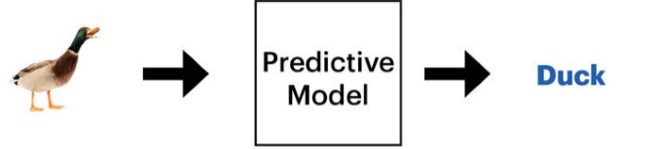
Example

Slide 7
THANKS!
@saifhassandr
Any questions?
Leave comments below.

